Slide 1

DeActivation Presents...
Punishment of the Gods

Slide 2
The Vision
3-D Running Platformer that is endless, with obstacles, such as boxes and rocks that the player has to evade, while running away from a giant boss.
Uniqueness: Boss that constantly chases the player narrows the running ground for the player, as well as interacting with the main character (tries to attack him constantly).
Mechanics: The player is able to move side to side (left and right), jump up while running, as well as dodge obstacles (tuck-and-roll).
Setting: Grassy, plains area set in Greek Age time period.
Look and Feel: Dark, shadowy (gloomy) look, with shimmering brightness that cascades along the path the player travels through. Character is afraid to be caught by the giant boss that follows him throughout the game. The character trips and falls throughout the game, but remains at a consistent speed.

Slide 3
The Gameplay
The player constantly moves right, while dodging and jumping over obstacles.
If the player hits an obstacle, the player slows down and gets closer to being captured by the giant boss chasing them.
If the player gets captured by the giant boss, this leads to the end of the game.
Gameplay is based on scoring points by collecting specific objects to add points to the user's final score.
The distance the player traveled before getting caught by the giant boss will also count towards the user's final score.

Slide 4
The Rules
Distance provides a way of gaining points consistently of 1 dragma (coin) per meter traveled in the game.
Tokens provide 25 dragma to the player's final score at the end of the game (after being caught by the giant boss).
The game only ends when the player is finally caught by the giant boss, meaning the player can never wins (Damn the Gods).
The walls are placed at the top (back) and bottom (front) of the map, which limit the character's movement.
Boxes and rocks provide a hindrance to the player in trying to escape the giant boss, by slowing the player's movement.

Slide 5
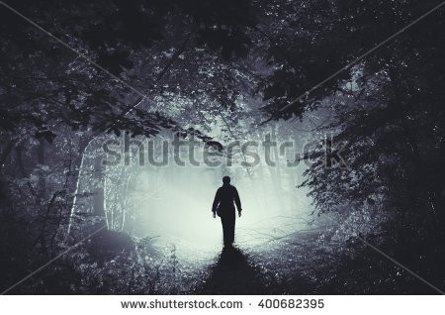
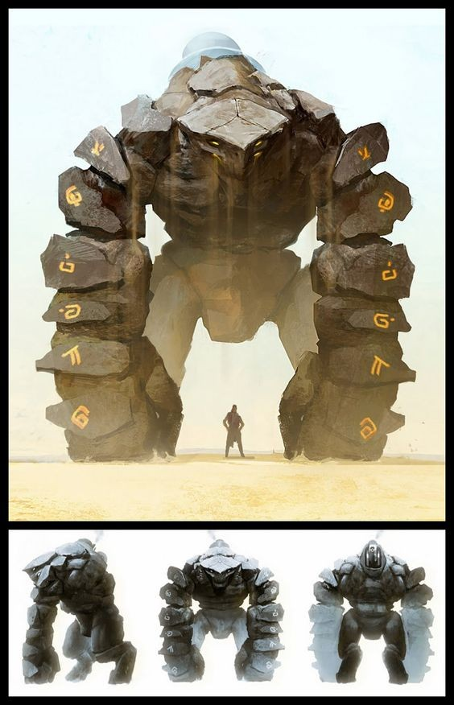
The Characters
Steve Rogers - A male, angel character, who is a conniving, mischievous angel (unlike the other angels), who does not like to follow orders or play by the rules (he makes his own rules). By angering the Gods for his poor behavior, he's stripped of his wings by the Gods and sent down to Earth as a human to forever run from the giant golem that constantly lingers behind him for the end of his days.
Baragnock - A giant, golem character, who is sent by the Gods to terrorize and hunt down Steve Rogers for the rest of his days. He's made out of rock, dirt, and lava. He's brought to life by the Gods for one purpose, chase and capture Steve Rogers. He's very aggressive and with a short temper, he's a deadly creature to run into (especially since we also has a giant sword).

Slide 6
The World
Overview: The map will be a 3-D and linear, where the character can only move right or left and can jump or dodge obstacles in his path. The map will be limited with two wall barriers (one in the front of the map, one in the back of the map) to limit the movement of the player. There will be obstacles in the players way that will appear at random to slow the player down. The background will be mixed of ancient ruins, tall mountains, and a cloudy sky with sunlight shining from the clouds.
Physical Objects: Rocks and boxes will appear at random to slow down the main character (Steve Rogers). Boxes will be able to be broken through at the cost of a one second slow down time. Rocks will be able to be jumped over. However, if the user fails to jump over the rock, their character will trip over the rock and cause a three second slow down time. All objects will be able to be dodged. Throughout the game, the Giant Boss (Baragnock) will be able to swing his sword, where the user will either have to dodge or jump over Baragnock's attack. If hit by the sword attack, the player will be stunned for three seconds (unable to move completely). A shadow will signify when Baragnock will swing his sword and in what direction he will be swinging his sword.

Slide 7
The Animations
We will be using Blender to add the different action animations.
This will include (but not limited to) the main character movements for when he's running, forcefully slowed down, moving up, down, left, or right, the actions he makes when he's jumping or dodging objects, when he's paralyzed and can't move, and when he has been caught by the giant boss.
Other animations will include the pace of which the objects (boxes and rocks) travel towards the player as they are running as well as the different movements of the giant boss.
The giant boss movements will include (but not limited to) his movement speed (which will be quite slow at first, then will get faster as the user progresses through the game) as well as his different attacking actions (two types of swinging actions his sword, vertical and horizontal swings) and the animation he makes when he captures the main character.
We will also include cloud movement as well as changing of scenery so the player will no through the background movement alone that they get the feel of their character is moving and progressing forward.

Slide 8
The Music/Sounds
We will do a mixture of playing our own music as well as using music editors (such as FL Studios) to create the music for the game.
We will then import the music into Unity and make the adjustments of the the music will be played that fit the requirements of Unity.
As for the sounds, we will personally record the sounds made in the game and edit those sounds using a music editor (probably FL Studios).
Finally, we will import these sounds into Unity and adjust the times these sounds will be made that will fit the requirements Unity sees fit.

Slide 9
QUESTIONS??

